Slide 1
Customer Segmentation with K-Nearest Neighbors(KNN)
Enhancing Retail Marketing Strategies

Slide 2
Introduction
KNN empowers retail marketing by segmenting customers based on their behaviors and demographics.
Data-driven approach can enhance customer engagement, leading to increased sales and retail success.

Slide 3
Data Preprocessing
Loading the data using pandas
Label encoding to convert categorical data (like 'Gender' and 'Profession') into numerical format.
It ensures that the data can be used effectively for modeling.

Slide 4
Data Splitting
Data divided into training and testing sets, which is crucial for evaluating the model's performance.
Spending score is testing dataset

Slide 5
KNN Model Training
K-Nearest Neighbors (KNN) model training using the original data.
It outlines the process of training the model
Presents performance metrics, including accuracy, confusion matrix, and a classification report.
Same process for scaled data too.

Slide 6
Data Scaling
Using the StandardScaler. It clarifies why data scaling is important for KNN,
As KNN relies on distances between data points and scaling ensures that all features have the same scale.

Slide 7
Hyperparameter Tuning
This slide explains the process of hyperparameter tuning using GridSearchCV.
It identifies the search for the optimal value of 'K' (number of neighbors)
Mentions the best 'K' value found.

Slide 8
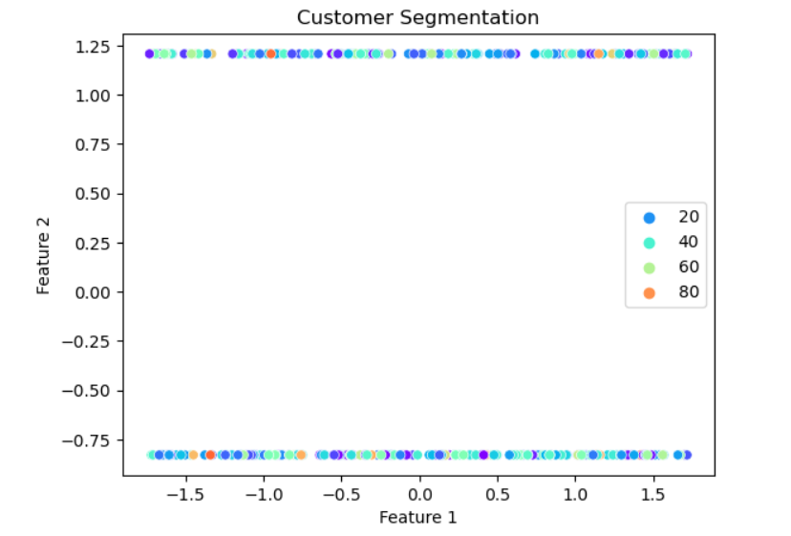
Visualizing Customer Segments

Slide 9
Performance Comparison (Unscaled vs. Scaled Data)
Performance on Unscaled Data:
Accuracy
Distance Metrics
Misclassification
Interpretability
Performance on Scaled Data:
Improved Accuracy
Balanced Contribution
Better Customer Segmentation
Interpretability

Slide 10
Conclusion and Recommendations
Data-Driven Insights
Improved Marketing Strategies
Enhanced Customer Engagement
Strategic Decision-Making

Slide 11

Questions?

Slide 12

Thank You

